Slide 1

Review: Paper Reading LSTM: A Search Space Odyssey
范老师
2020/05/24

Slide 2
Content
Introduction
Vanilla LSTM
History of LSTM
Evaluation Setup
Results and Discussion
Conclusion

Slide 3
Introduction
LSTMs are both general and effective at capturing long-term temporal dependencies.
The central idea behind the LSTM architecture is
- a memory cell : 记录每时刻的状态
- non-linear gating units : 正则化进/出memory cell的信息
Eight different variants on three benchmark problems: acoustic modeling, handwriting recognition and polyphonic music modeling
Each variant differs from the vanilla LSTM by a single change.

Slide 4
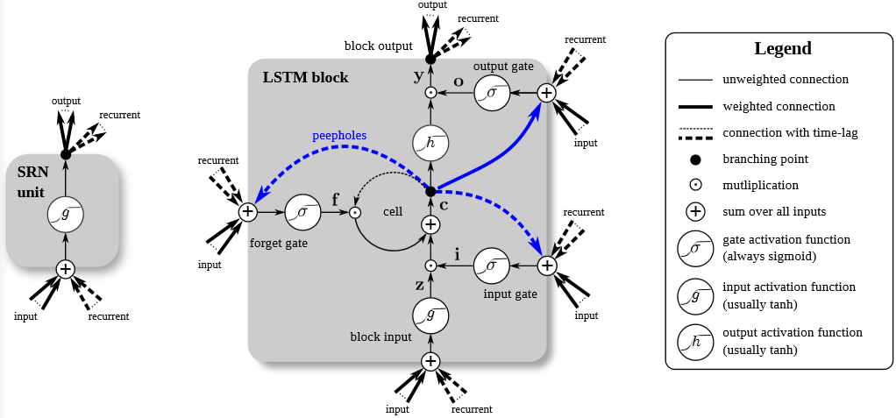
Vanilla LSTM

Slide 5
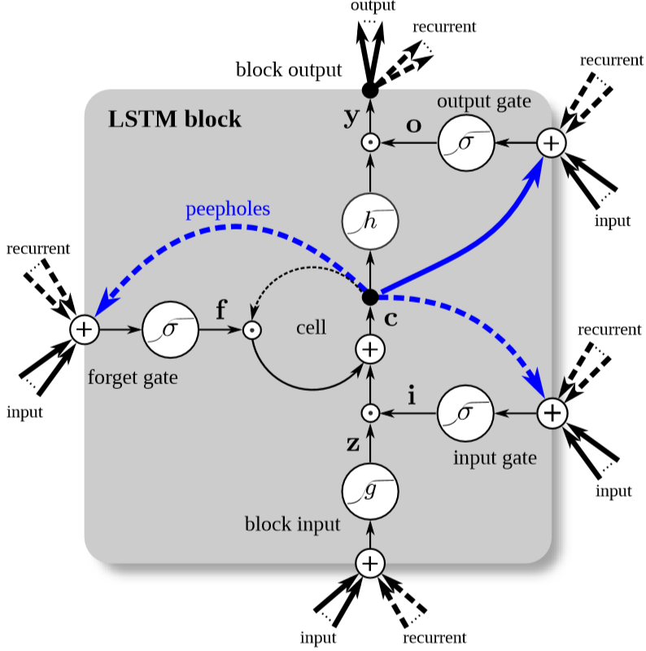
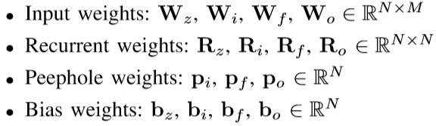
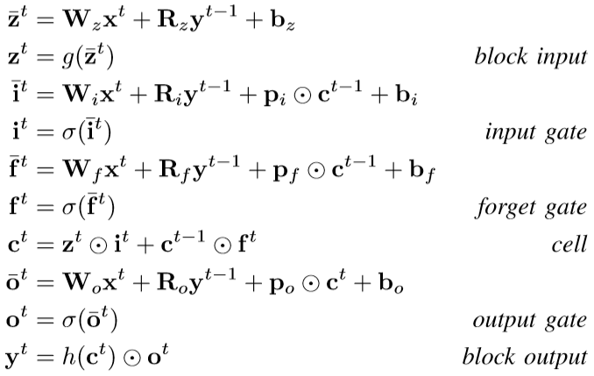
Vanilla LSTM - Forward Pass

Slide 6
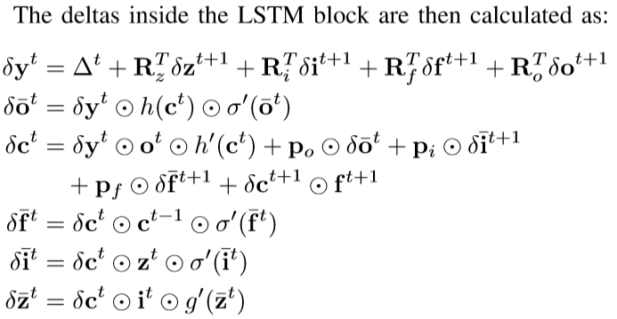
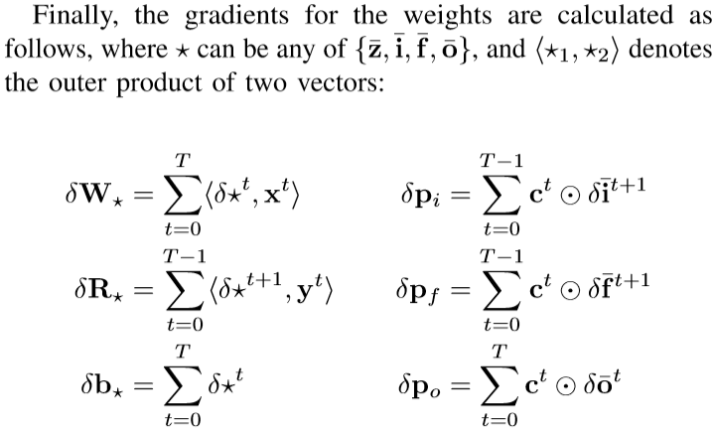
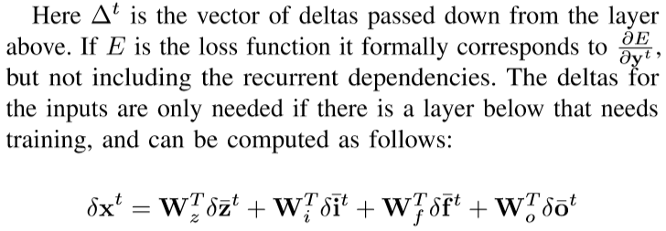
Vanilla LSTM – Backpropagation Through Time

Slide 7
History of LSTM
Original LSTM:
cells, input and output gates
only the gradient of the cell was propagated back through time
A. Forget Gate:
For resetting own state
B. Peephole Connections:
For making precise timing（蓝线）
C. Full Gradient:
Full propagation through time training（不仅仅更新cell的权重）
D. Other Variants:
基于模型结构和训练方式的改造，尤其是GRU（input+forget合并）

Slide 8
Evaluation Setup
The vanilla LSTM is used as a baseline and evaluated together with eight of its variants.
Each variant adds, removes, or modifies the baseline in exactly one aspect.
They are evaluated on three different datasets from different domains.
每个变种使用random search单独调参

Slide 9
Evaluation Setup
Datasets
TIMIT: acoustic modeling dataset, classification
IAM Online: handwriting database,
JSB Chorales: 巴赫的几百首四声部的音乐集
B. Network Architecture & Training
- JSB Chorales: a single LSTM hidden layer + sigmoid output layer
- TIMIT and IAM Online tasks: Bidirectional LSTM
- Training with stochastic gradient descent
- Stops at 150 epochs or no improvement after 15 epochs

Slide 10
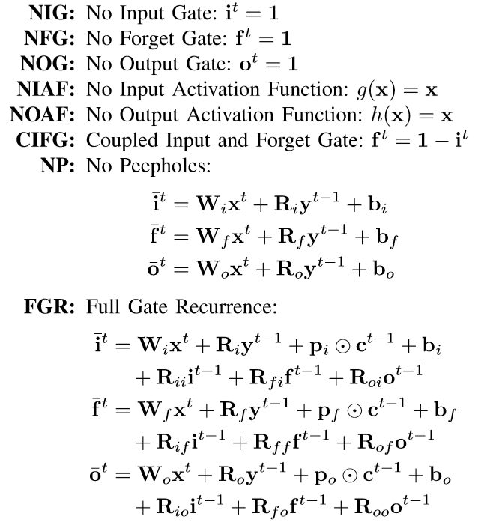
Evaluation Setup - C. LSTM Variants

Slide 11
Evaluation Setup - D. Hyperparameter Search
Random search for each combination of 9 variants + 3 datasets
200 trials for each combination
- number of LSTM blocks per hidden layer
- learning rate
- momentum（梯度变化小的时候使用）
- standard deviation of Gaussian input noise
3. No fix number of parameters

Slide 12
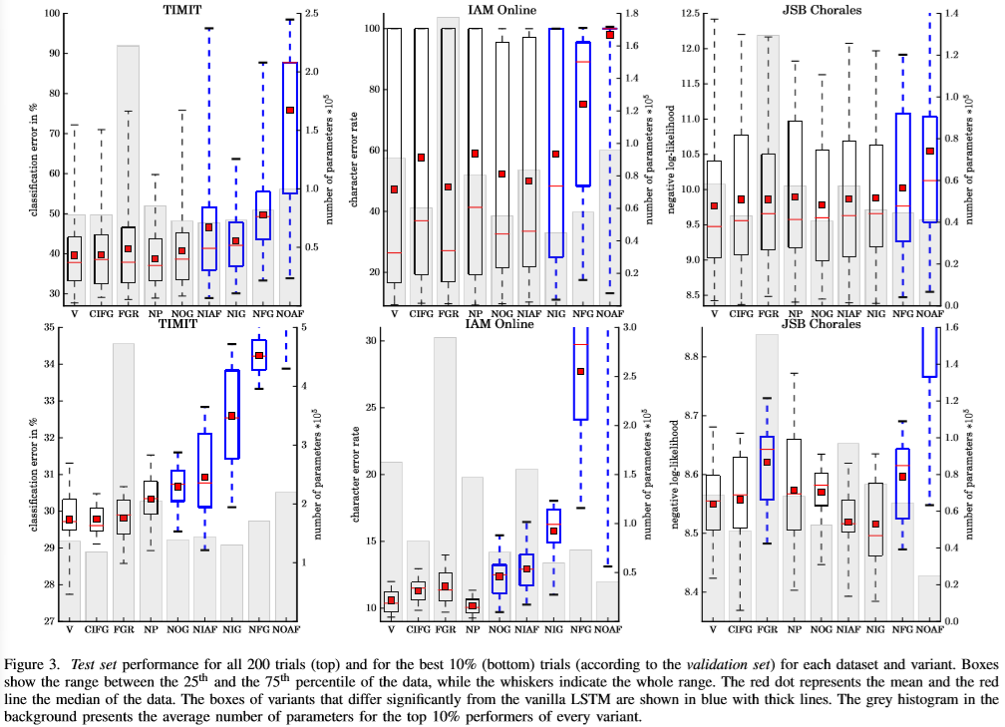
Results and Discussion – Comparison of the Variants
The most important factors: input gate, output gate, forget gate, the activations of input and output gates
For lower computational complexity, CIFG and NP can be considered
右边是参数的个数
虚线：最好和最坏的误差
红色点：中位数
蓝色：表现不好的
装箱图

Slide 13
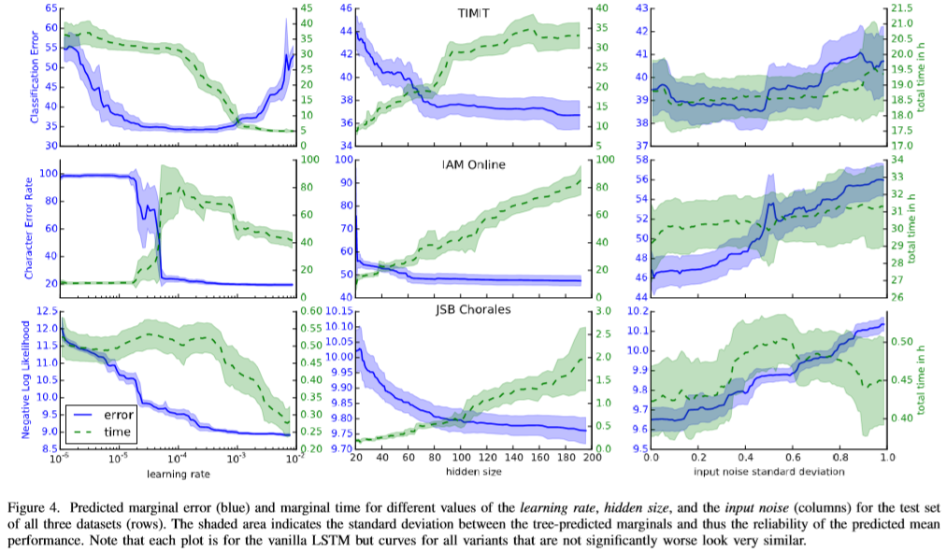
Results and Discussion – Impact of Hyperparameters

Slide 14
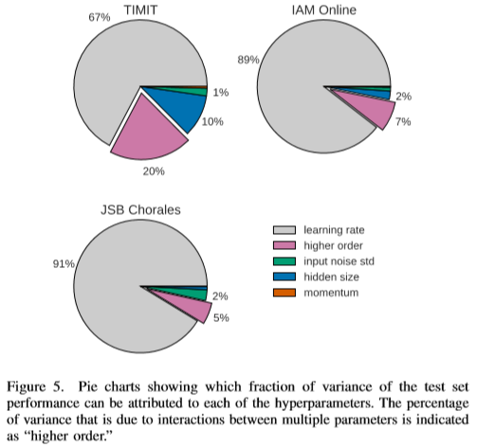
Results and Discussion – Impact of Hyperparameters
Learning rate is the most important parameter
Hidden size is the second important parameter
No need to consider higher order, just suppose each parameter is independent with each other
higher order：交叉特征

Slide 15
Conclusion
1. 没有任何一个LSTM变体的性能比标准的LSTM体系结构要高。
2. 在保证模型效果并没有显著降低的情况下，Coupling the input and forget gates / removing peephole connections降低了参数量和计算复杂度。
3. Forget gate和output activation function是LSTM结构中重要的部分，去掉任意一样，会严重影响模型效果。
4. 学习率和网络规模是两个重要的超参数。Momentum和Gaussian noise对于模型的预测效果帮助不大。
5. 超参数直接的关系对于模型的表现影响不大，训练时，可将超参数看作互为独立。
6. 神经网络对于初学者来说是经验性的学科，所以论文尝试了不同的网络解构、参数搭配等等去找寻最好的实验结果

Slide 16
Reference
[1] Greff, K., Srivastava, R.K., Koutník, J., Steunebrink, B., & Schmidhuber, J. (2017). LSTM: A Search Space Odyssey. IEEE Transactions on Neural Networks and Learning Systems, 28, 2222-2232.
[2] Embedded Reber Grammar https://zhuanlan.zhihu.com/p/137862968
[3] 反向传播求导过程 http://neuralnetworksanddeeplearning.com/chap2.html https://www.cnblogs.com/timlong/p/11661990.html
[4] 理解LSTM http://colah.github.io/posts/2015-08-Understanding-LSTMs/

Slide 17
Thanks!

